Slide 1

Self Hosted Agent Pool management using Azure Automation and DSC
Presenter Name: Aatif Akhter
Date: 20 October 2022

Slide 2

User Story/Problem Statement
As a DevOps,
I want to create self hosted agents in ADOS with capabilities (dotnetcore, node js, VS 2022 community edition, Az PowerShell etc.),
So that I can run ADOS builds and releases and can serve as a test infrastructure resource

Slide 3
Approach to the problem
Azure DevTest Lab to create Azure DTL instances for better governance
PowerShell desired state configuration (Infrastructure automation tool and used for Infrastructure as a Code) to make sure the capabilities are available on VM
Azure Automation account to give a platform to host DSC config and apply a pull mode

Slide 4
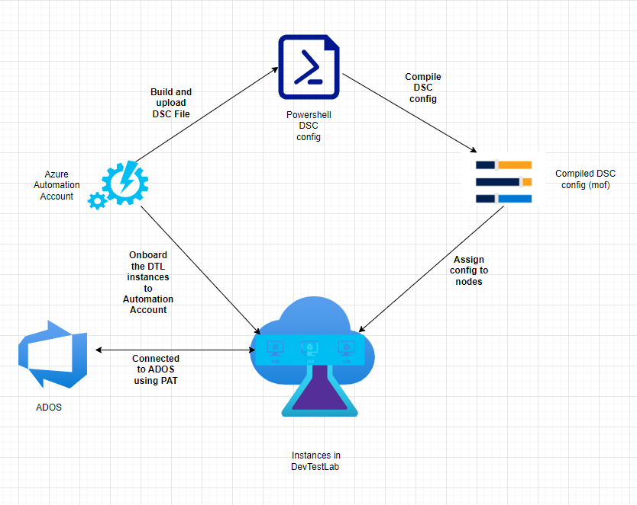
Approach to the problem…

Slide 5
Self Hosted Pool with DTL & DSC
Advantages:
Better governance and control
Security reasons
Software dependency – sometimes we are not ready to go with latest version of software given by MS
Cost reduction (When you stop the VMs during none office hours when builds and releases are not running)
DSC ensures compliance
Any change in software version or new software addition is a matter of addition/modification one more config in DSC
Disadvantages:
Manage resources by yourself is high effort
Cost ADOS: Costing ADOS Pools

Slide 6
Overall setup summary
Setting Up Infra
Applying DSC (Pull MODE)
Setting UP Agent Pool
Create Azure Resource Group
Create Azure vNet and subnet
Create Azure DevTest Lab
Create DevTest lab instances (windows server 2016)
Create Azure Automation Account
Create DSC Configuration for VMs
Import necessary modules in Azure Automation Account
Upload Configuration to Azure Automation Account
Compile Configuration
Apply configurations to nodes
Create Agent Pool
Create a PAT token with manage Pool Permission
Configure DTL instances using PAT
Run Builds, Releases or Tests

Slide 7

Demo

Slide 8
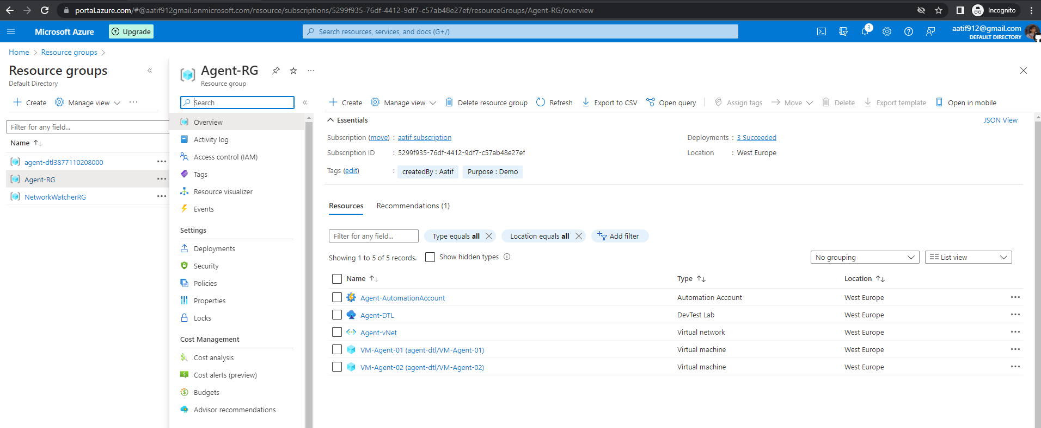
Screenshots

Slide 9
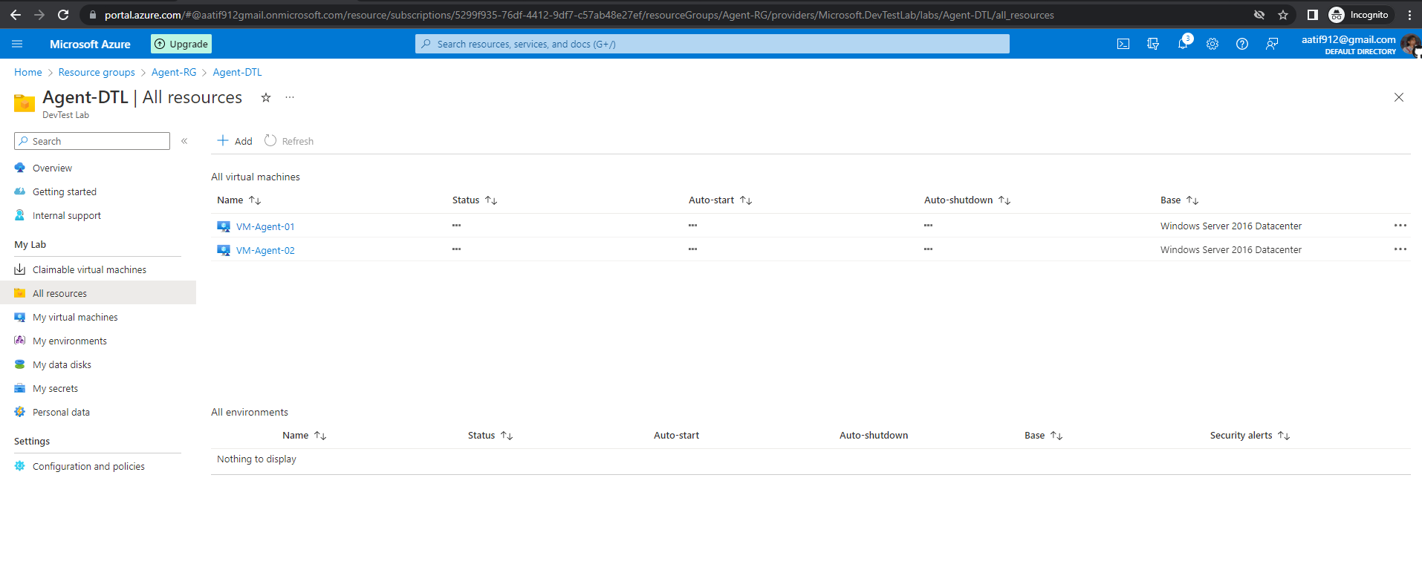
Screenshots…

Slide 10
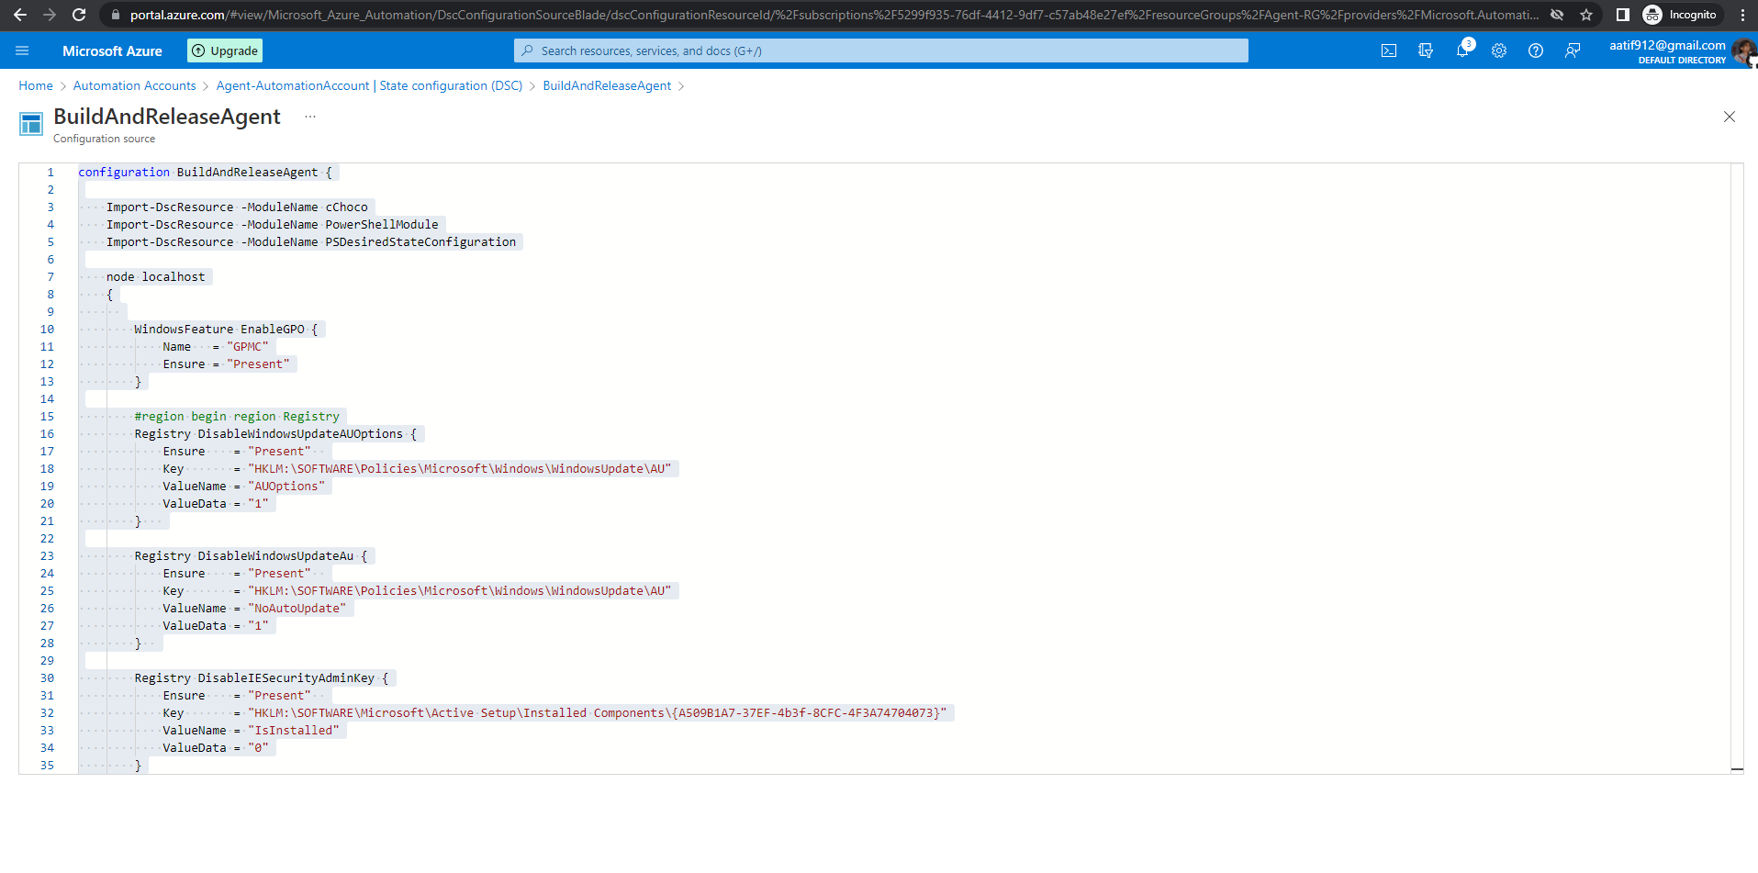
Screenshots…

Slide 11
DSC Config Ps1 file
https://github.com/aatif912/Agent-DSC/blob/main/BuildAndReleaseAgent.ps1
OR
Azure Portal Automation Link

Slide 12
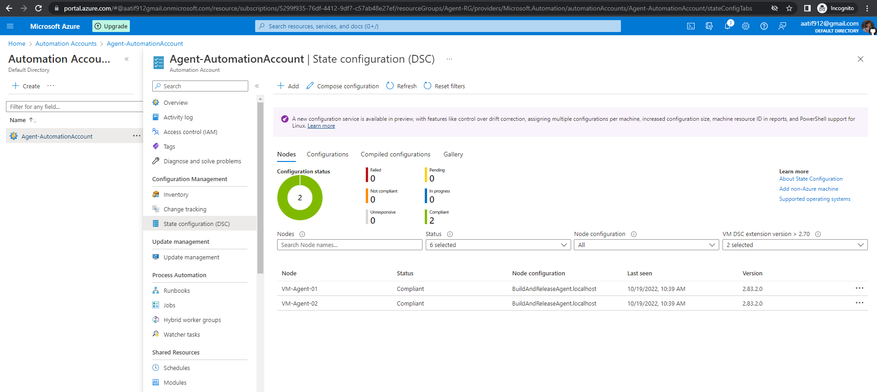
Screenshots…

Slide 13
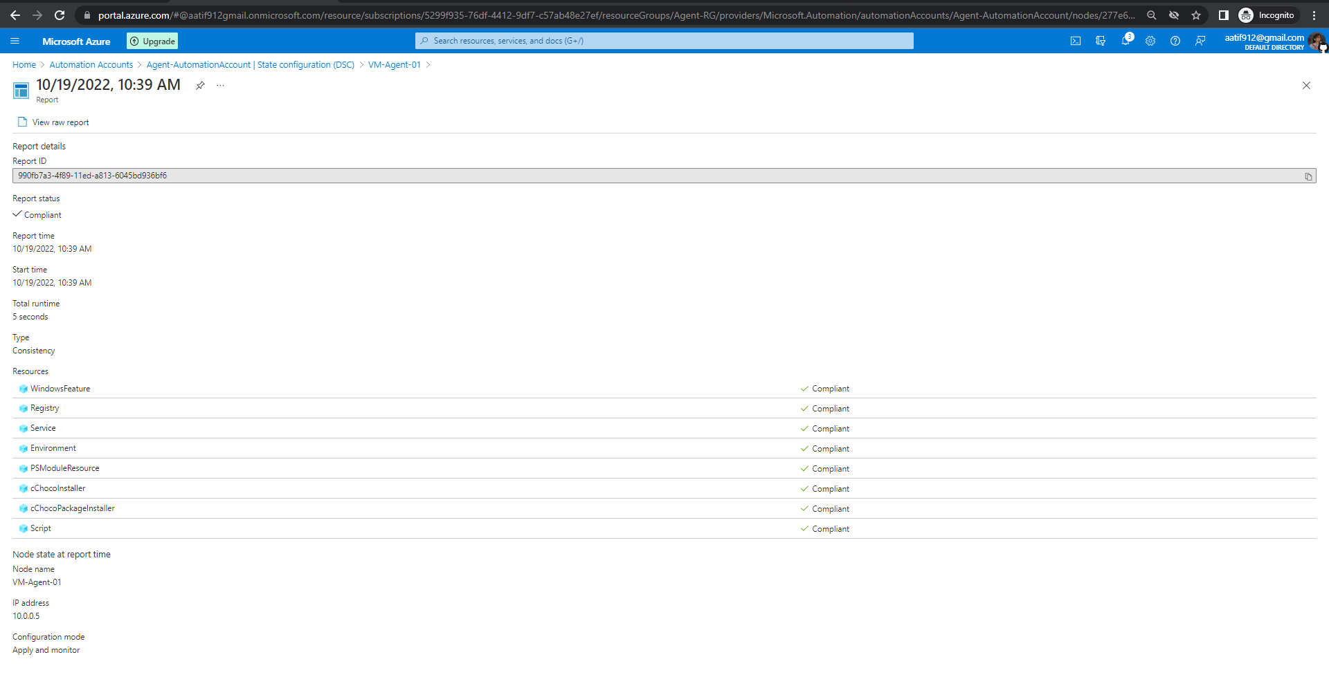
Screenshots…

Slide 14
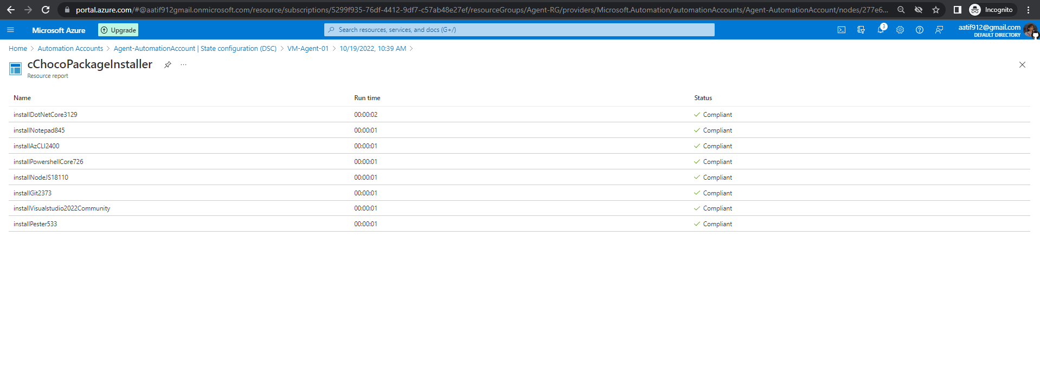
Screenshots…

Slide 15
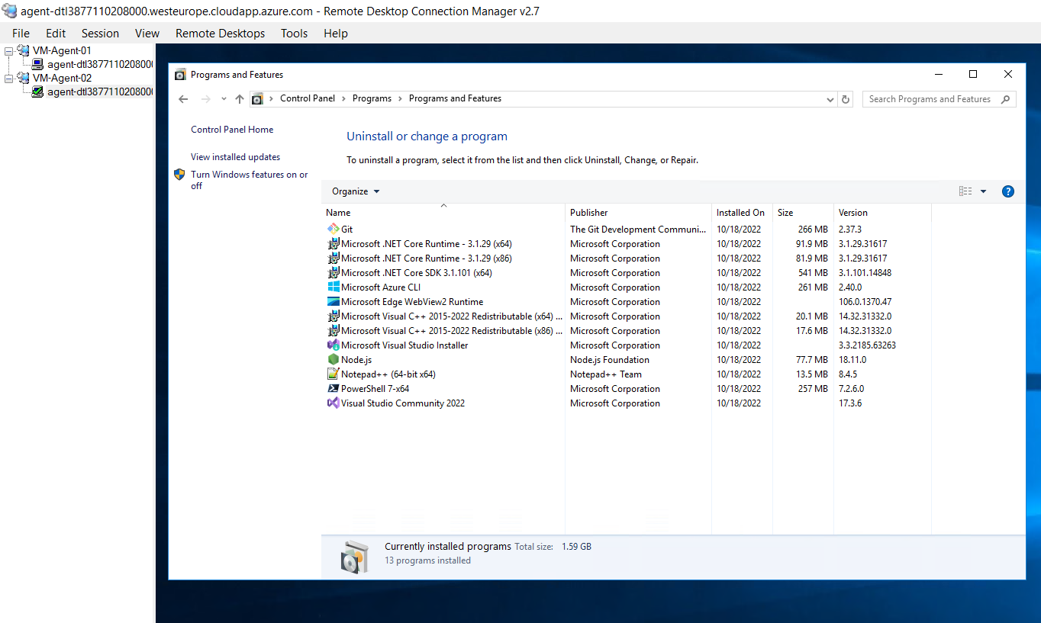
Screenshots…

Slide 16
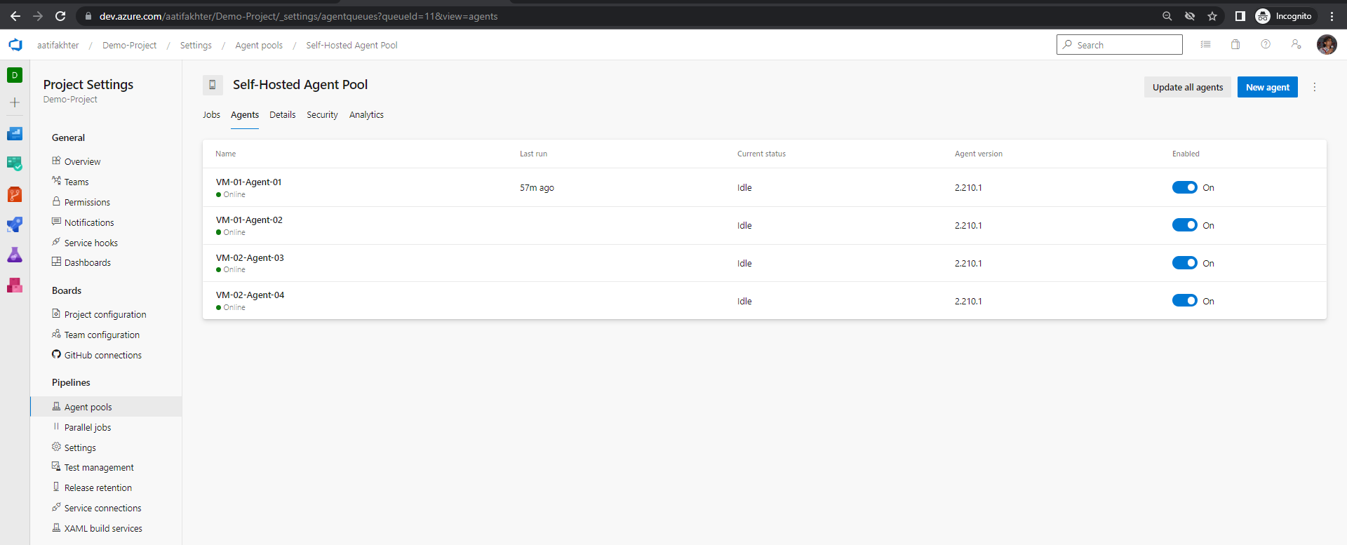
Screenshots…

Slide 17
Scope of Improvements
All needed azure resources can be created using Terraform/ARM (RG, vNet, DTL, VMs, Automation account etc.)
PowerShell Az scripts can be used to upload, compile and apply the node config
PowerShell Script can be used as custom script extension to install agents within the VMs
Whole automation script can be wrapped in an ADOS release pipeline and the environment creation can be achieved in single-click

Slide 18
Thank You ☺
Presenter name: Aatif Akhter
Email address: aatif.akhter912@gmail.com
GitHub: https://github.com/aatif912/Agent-DSC

Slide 19

Q&A

